Slide 1
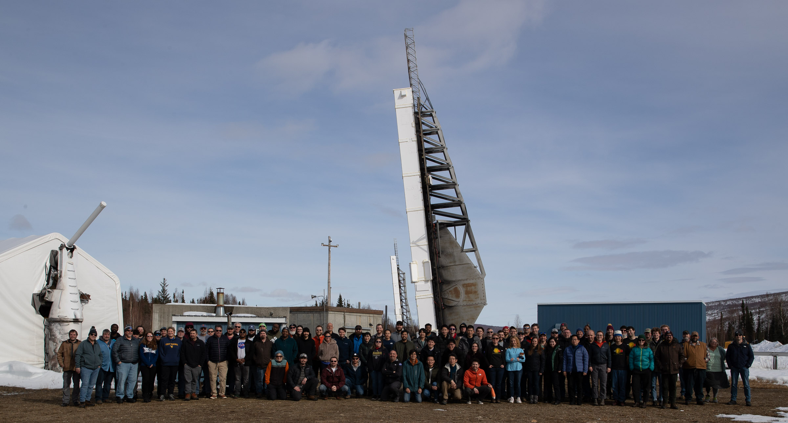
The first Solar Flare Sounding Rocket Campaign
Lindsay Glesener
University of Minnesota
On behalf of the FOXSI-4, Hi-C, and Solar Flare Campaign teams
Sounding Rocket Working Group Meeting, July 9 2024
Notes:
Add Sabrina’s name if she gives me the go-ahead to do so.

Slide 2
Why do a solar flare campaign?
Dynamic events on the Sun are the subject of many astrophysical investigations and have direct impacts on the near-Earth environment.
Solar flares and coronal mass ejections cannot be predicted in advance with any precision. If you want to catch one, you have to sit and wait for it.
Rocket campaigns allow us to…
do cutting edge science immediately with state-of-the-art instrumentation, instead of waiting 1-2 decades for a spacecraft.
develop and validate instrumentation for flares/ejections, rather than only testing on the (orders of magnitude lower) fluxes of the quiescent Sun.
better optimize future space missions by having an idea of what we’d see!
Notes:
Add an image.
See if I can find out what fraction of Sun papers are about flares.

Slide 3
The guinea pigs
FOXSI-4
Goal: Investigate particle acceleration and plasma heating in a big solar flare.
Target flare: Large flare, prefer >GOES C5 class, prefer impulsive phase.
Hi-C Flare
Goal: Investigate continued flare heating in the decay phase
Target flare: Large flare, prefer >GOES C5 class, long-duration flare (>20 min) observed during decay phase
SNIFS
Explore energetics and dynamics of flaring chromosphere
Delayed to future attempt due to hardware damage
Persistence! SNIFS team worked with FOXSI-4 and Hi-C to plan flare campaign.

Slide 4
NASA’s first solar flare sounding campaign occurred in April 2024.
First attempt (ever!) to intentionally capture a solar flare with a sounding rocket observation. (Observation time 5-6 minutes)
Motivation from Winebarger et al. (2019) white paper.
Payloads selected for the campaign in 2020 (yikes!)
FOXSI-4 and Hi-C → simultaneous observation
SNIFS gets its own flare → delayed to later attempt
Launch site: Poker Flat Research Range in Alaska
Chosen for launch time flexibility → critical capability for flare campaign
First solar launches from this location / first SPARCS usage here / rare daytime launches.

Slide 5
Is it feasible to catch a flare with a rocket?
Flare occurrence rates over year prior to campaign
Probabilities of success were estimated by simulating many campaigns over the past year with actual flaring activity.
For a “realistic scenario” (12 days, 3 hrs/day), we estimated these probabilities:
1+ flare >C5: 85%
2+ flares >C5: 67%
1+ flare >M1: 60%
2+ flares >M1: 33%
Decent chances!
It strongly depends on solar activity.
Notes:
Verbally credit Milo

Slide 6
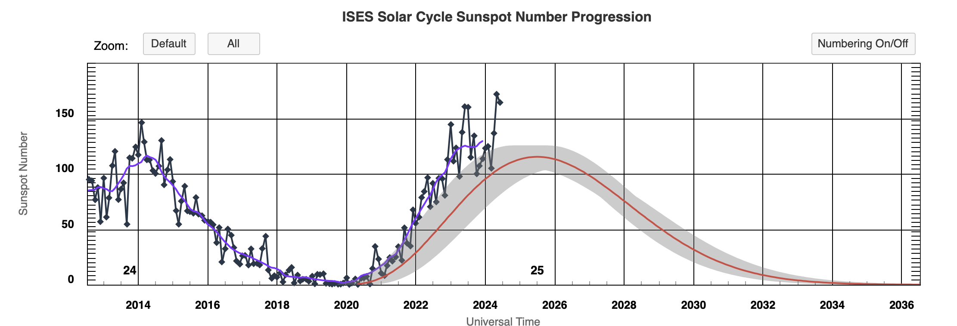
Is it feasible to catch a flare with a rocket?
Probability of success goes down as the years go by. Next 2-3 years are only possibility for another flare campaign until mid 2030s. As time goes on past 2025 it becomes more likely that campaigns will need to be extended or will not be successful.
Notes:
Verbally credit Milo

Slide 7
Even near solar maximum, the Sun can make you wait for it!
4 hour launch window each day: 11:53 to 15:53 local time
Countdown clock was held at T-3 minutes for entirety of each 4-hour window.
Original plan was for a 14-day campaign including 2 days off, but circumstances limited us to 9+1 attempts. (We launched on 8th attempt.)
C5
C5
Blue windows were carried out with no lucrative flares within the window.
April 17:
We launched on this flare!

Slide 8
An army of flare monitoring tools was built for the occasion!
Early Large Solar flare Alert system: “ELSA”
GOES/XRS lightcurves, temperature, emission measure
Trigger conditions, whether they’ve been met, and status
EOVSA realtime lightcurves
AIA emission measure maps for flare location – WAFFLES system built by WKU
“Anna”
GOES/XRS and EVE/ESP derivatives
Not pictured: Real-time prediction of remaining flare duration à la Reep & Barnes (2021)
EVE/ESP lightcurves, GOES proxy, and time extrapolation
“Kristoff”
Notes:
Should credit the EVE/ESP work (and, really, all the others!)

Slide 9
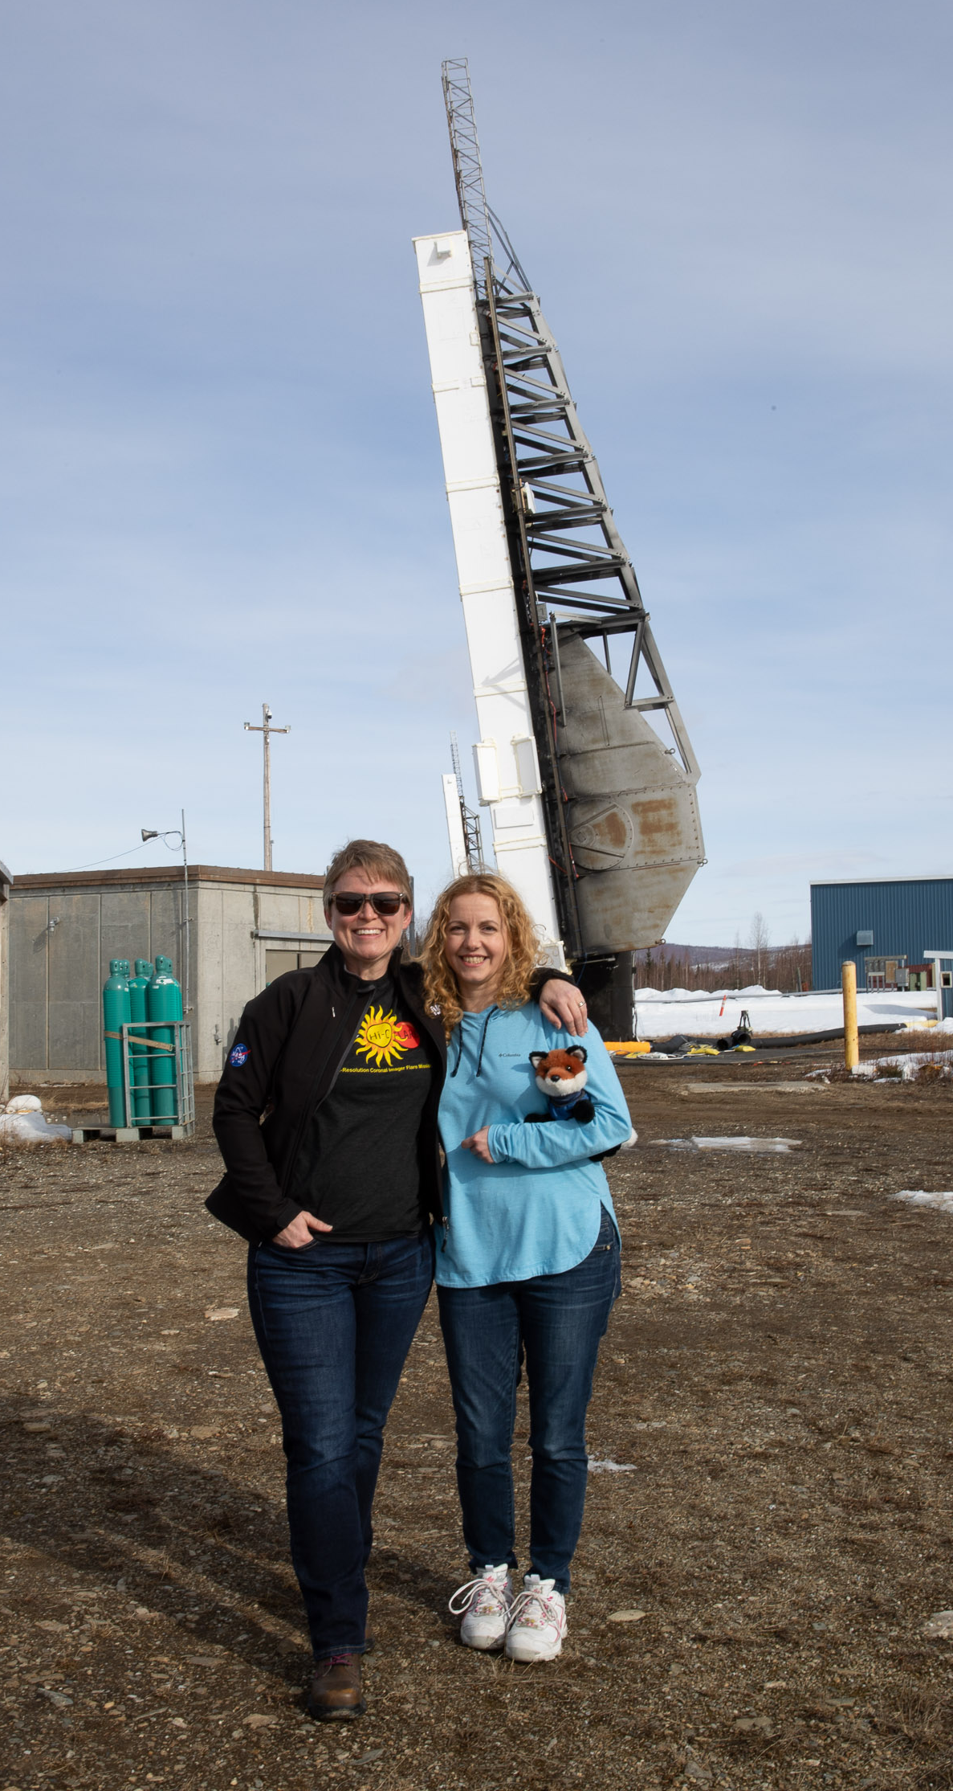
FOXSI-4
Hi-C Flare

Slide 10
FOXSI-4
Approximate observation times
First launch ~7 min after picking up the 3 min count. Two holds within 3 min (one science, one range).
Hi-C

Slide 11
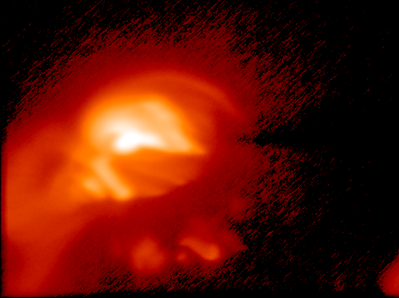
Sneak peek at results from FOXSI-4: M1 solar flare
Soft X-ray image →
Hard X-ray movie + spectrum:
All measurements are single-photon detection. → Spectra can be made for any region in the image.

Slide 12
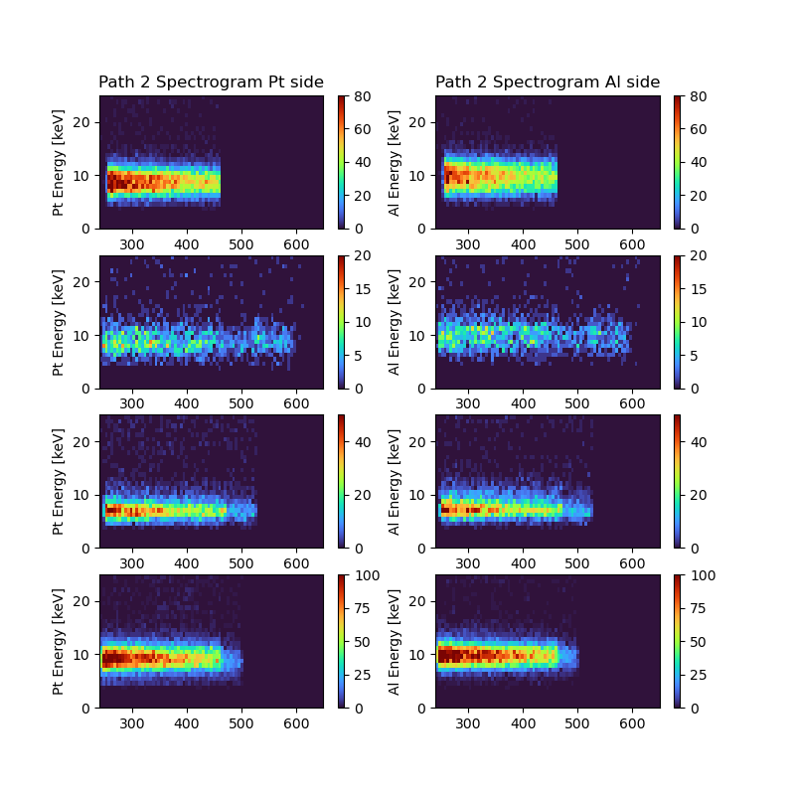
Time, position, and energy for every photon.
Lightcurves and spectra in every pixel!

Slide 13
Assessment of operations
Overall, the SRPO and PFRR arrangements worked very well for what we needed. We launched both rockets successfully on the first good flare that occurred during the campaign.
Areas of difficulty:
Non-NASA access to telemetry data (UMN couldn’t access the NASA Mission Network)
BUT other than this, the EVTM ethernet-based approach was great for FOXSI-4, and accessing this on a dedicated network at WSMR worked out nicely.
Lack of flexibility in end date of campaign due to SRPO schedule and air space access.
Notes:
If Sabrina has not weighed in on this, make it clear this is my opinion only.

Slide 14
Closing thoughts
The EXP teams are grateful to the heroic efforts from SRPO, NSROC, PFRR, and a wide swath of solar scientists from several countries to put this successful campaign together!
The target flare was a complex, evolving eruptive event, and the first to be capture in ultra high resolution EUV and direct hard X-ray imaging. The acquired data hold tremendous potential for flare science.
A triggered launch on a solar flare is possible (obviously), and our analysis shows it is consistently possible; look for Peterson et al. (in prep) and Vievering et al. (in prep) for a full rundown of the statistical probabilities and the ways to trigger a launch.

